Slide 1





Slide 2

CONTENT
01
DESCRIPTION
02
CONTENT
03
VOLUME OF REPOSITORY
04
THE FOUNDER
05
MATERIAL
06
METADATA
07
EXAMPLES OF ITEMS
08
EXAMPLES OF METADATA
09
ADDITIONAL FEATURES

Slide 3

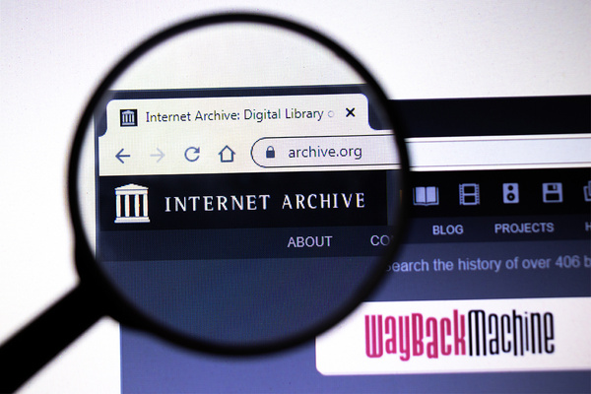
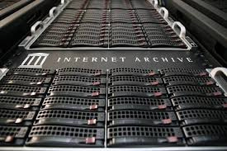

DESCRIPTION
A public, nonprofit digital library that was established in 1996. The organization's declared goal is to grant "universal access to all.
The Archive is an activist group that promotes a free and open Internet in addition to serving as an archive, it is creating a digital library of online resources and other preserved cultural relics.
The Internet Archive aims to make digitized books accessible to individuals with print impairments, ensuring they can interact with traditional books effectively.
It offers free access to a variety of digital resources, including print, video, software, websites, and music.

Slide 4


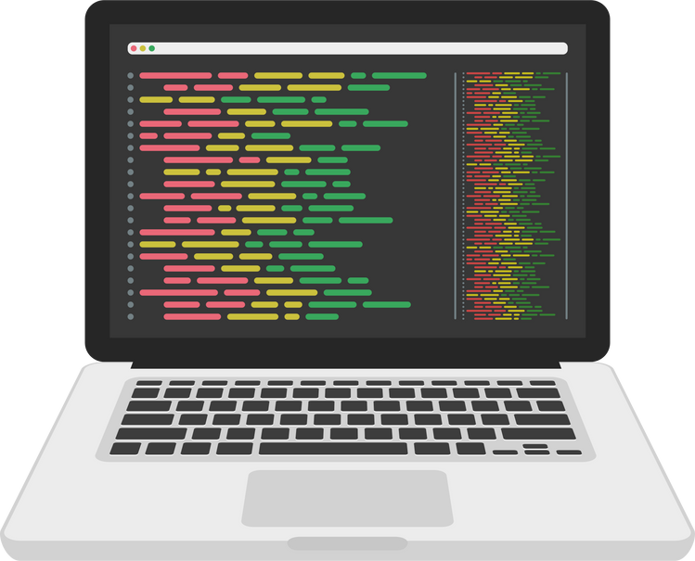




CONTENT
MOVIES
BOOKS
SOFTWARE PROGRAMS
WEB PAGES
There is a collection of over 11 million movies
There is a collection of over 36 million books
This includes over 500 000 software programs
The Internet Archive has over 400 billion webpages
IMAGES
MUSIC
VIDEOS
MUSIC
VIDEO
There are over 400 million images
This includes over 2 million recordings of live music, radio broadcasts etc
There are over 3 million videos

Slide 5


VOLUME
01
01
02
03
04
BOOKS/MUSIC/VIDEO COLLECTIONS:
WAYBACK MACHINE:
UNIQUE DATA:
TOTAL USED STORAGE:
42 PetaBytes
57 PetaBytes
99 PetaBytes
212 PetaBytes

Slide 6
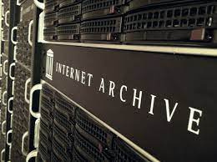


FOUNDER
Brewster Kahle is the founder of the Internet Archive; he is an advocate of universal access to all knowledge and therefore he manages the digital repository with the same sentiment.

Slide 7

MATERIAL
The Internet Archive gets its materials from donations from different libraries and universities
Anyone with a free account can also upload content

Slide 8
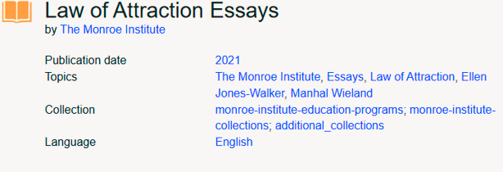
METADATA
Standard Internet Archive Metadata
This includes metadata fields such as contributor, creator, date, language, description and other fields
Custom Metadata fields
These give the user the option to define which metadata format best suites the needs of their material. Users can define as many custom metadata fields as they require

Slide 9



EXAMPLES OF ITEMS
MOVIES
BOOKS
SOFTWARE
An example of an item in the Internet Archive digital repository is a movie titled:
summertime-sadness-capcut-template-7
An example of an item in the Internet Archive digital repository is a Book titled:
Adventures of Sherlock Holmes, Doyle, Arthur Conan, 1859-1930
An example of an item in the Internet Archive digital repository is Software titled:
Internetarchive Python Tool Test Cases

Slide 10
EXAMPLES OF METADATA
Date
Publisher
Adder
This is the publication or production date. For example, 2018-07-30
This is the publisher of the material available in the item. For example, Dzanc Books (Detroit, MI)
The name of the account that added the item. For example, mbali_k

Slide 11

ADDITIONAL FEATURES:
The Blog segment of Internet Archive allows users to find latest announcements and events.
OpenLibrary.org offers a free digital lending library of over 2 million eBooks, and a unique project to create one web page for every book published.
Current job openings at the internet Archive include positions such as Software engineering and Program officer.
BLOG
PROJECTS
JOBS

Slide 12
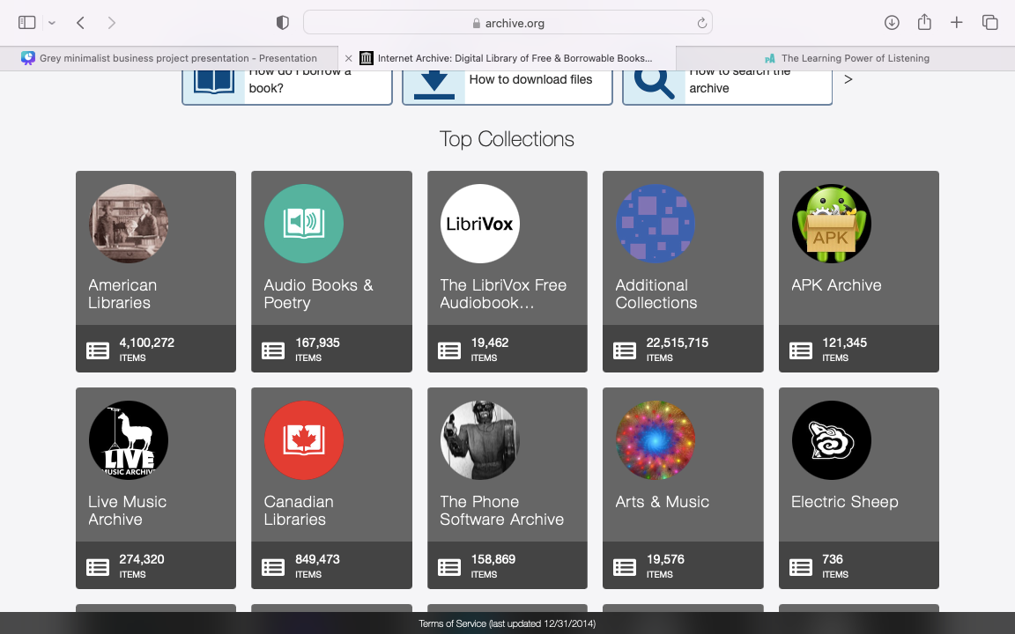
TOP COLLECTIONS

Slide 13



S’lindokuhle Khoza – u21513989
Vhuhwavho Mudzwiri – u21566560

